Slide 1








ANALYZING EMERGING IT SKILLS
SAFRIN S
SEPT 2023

Slide 2
A Journey Through Stories and Trends
Imagine this: It's a bright morning, and I'm sitting at my desk, scrolling through the latest tech news. As a tech enthusiast, I can't help but wonder about the ever-changing landscape of programming languages and databases. This curiosity led me to delve deep into the Stack Overflow Developer Survey data of 2019 and the anticipated trends for the upcoming year. I discovered that, much like my own journey in tech, JavaScript has remained a steadfast companion for developers. It's the language that powers the dynamic web we interact with daily. But what about Python? It’s rise reminded me of a colleague who transitioned from a non-tech background into data science, showcasing the versatility of this language. Then there's TypeScript, a name that started making waves in our team's discussions. I recalled how it introduced static typing to JavaScript, improving code quality and making development a smoother ride.
As I read about the challenges of gender disparity, it struck a chord with me. I remembered a brilliant female developer I met at a tech conference, who defied stereotypes and inspired those around her. Thinking about technology gaps in developing countries, I couldn't help but reflect on a recent documentary I watched. It highlighted how access to technology transformed lives in remote villages, where simple smartphones connected people to a world of opportunities. And finally, the issue of discrimination resonated deeply. I remembered the frustration of a friend who faced age-based discrimination during a job hunt, despite years of experience.
So, as we journey through this presentation, let's explore these stories and statistics together. It's a narrative that mirrors our own tech experiences and those of our global community.

Slide 3



OUTLINE
Executive Summary
Introduction
Methodology
Results
Visualization – Charts
Dashboard
Discussion
Findings & Implications
Conclusion
Appendix

Slide 4

EXECUTIVE SUMMARY
The purpose of this report is to analyze emerging IT skills based on the Stack Overflow Developer Survey 2019 data. This analysis aims to provide insights into current technology usage, future technology trends, and respondent demographics.
Understanding the demographics of the developer community is essential for talent acquisition and diversity initiatives.
This report serves as a foundation for informed decision-making in the ever-evolving field of IT skills development.

Slide 5

INTRODUCTION
About :
This report presents the findings of our analysis of the Stack Overflow Developer Survey 2019 data, which offers valuable insights into the preferences, aspirations, and demographics of developers worldwide.
Purpose :
In today's fast-paced and ever-evolving technology landscape, staying ahead of the curve is paramount for organizations seeking to remain competitive and innovative.
As technology continues to drive business transformation, it is crucial to identify and understand emerging IT skills and trends that will shape the future of the industry.
The ability to adapt to these changes and align skill development strategies with industry demands is a key success factor for IT and consulting services firms.
Audience : Human Resources and IT Head

Slide 6

METHODOLOGY
Data Collection:
Data collection involved obtaining the Stack Overflow Developer Survey 2019 dataset. Information was gathered using a combination of Application Programming Interfaces (APIs) and web scraping techniques.
Data Preprocessing:
Steps included addressing missing values and handling duplicates to maintain dataset accuracy. Normalization of data was conducted to facilitate meaningful comparisons and calculations.
Exploratory Data Analysis (EDA):
EDA techniques were applied to uncover patterns, correlations, and key trends within the dataset. Outliers were identified and assessed for impact on the analysis.
Visualizations:
Visualizations played a significant role in presenting the findings effectively. Charts, graphs, and tables were generated.
Visualization techniques were employed to convey trends and insights in an accessible manner using IBM Cognos Analytics.
Limitations:
Findings are limited to the available dataset and may not represent the entire developer community.

Slide 7
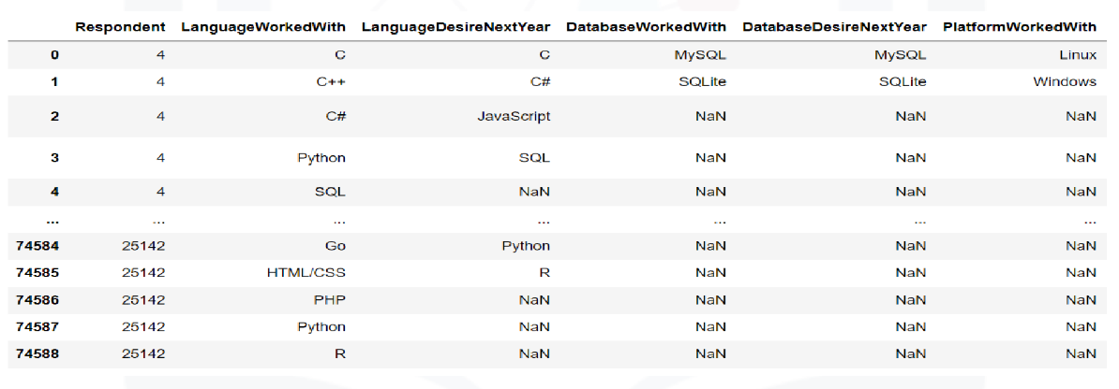
RESULTS
The results of the analysis of Stack Overflow Developer Survey 2019 data provide valuable insights into the current technology landscape, emerging trends, and the demographics of the global developer community.

Slide 8
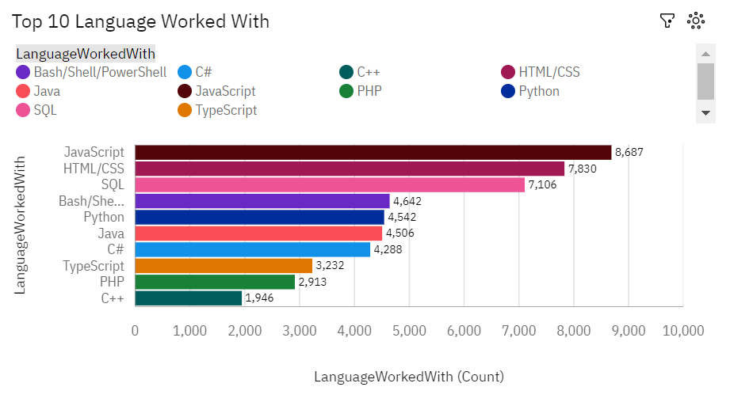
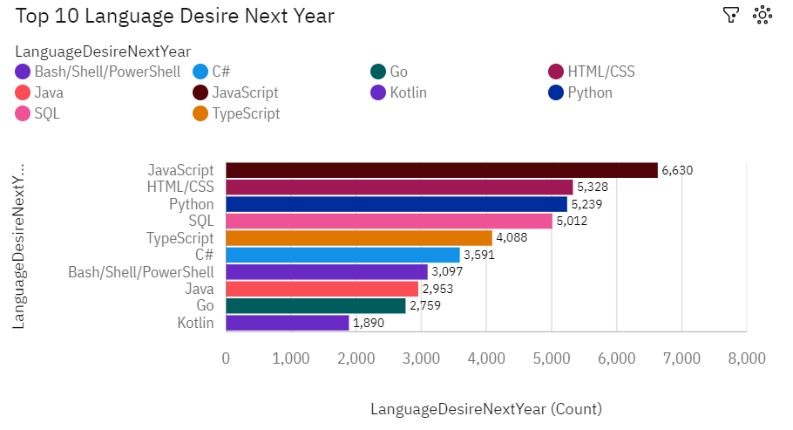
PROGRAMMING LANGUAGE TRENDS
Current Year
Next Year

Slide 9
PROGRAMMING LANGUAGE TRENDS - FINDINGS & IMPLICATIONS
FINDINGS
JavaScript emerges as the most widely used programming language
Python and TypeScript are gaining traction, with a notable increase in popularity.
PowerShell's cross-platform capabilities make it versatile for tasks such as automation and scripting across different operating systems
IMPLICATIONS
Organizations should prioritize JavaScript and Python training programs to equip their teams with essential skills
Python's growing popularity indicates its versatility and applicability across various domains, including data science and machine learning
A slight decline in sql suggests a potential trend toward alternative database technologies or NoSQL solutions

Slide 10

Can you guess which programming language is the most versatile ?

Slide 11

Yes, It’s Python. You got it!

Slide 12
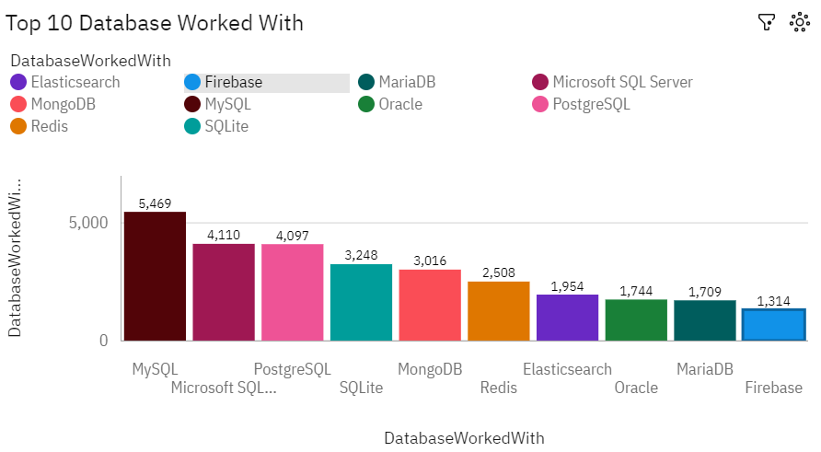
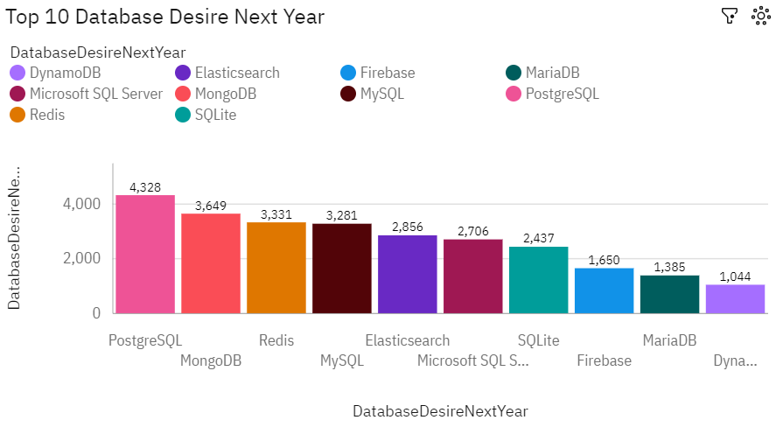
DATABASE TRENDS
Current Year
Next Year

Slide 13
DATABASE TRENDS - FINDINGS & IMPLICATIONS
FINDINGS
PostgreSQL and Mongo DB emerges as top databases in upcoming years
Redis and Elasticsearch consistently maintain positions in the top database rankings
MySQL and Microsoft SQL Server shows decline in user base for upcoming years
IMPLICATIONS
Organizations should consider PostgreSQL as a go-to choice for various data storage needs
Open-source databases are preferred for cost-effectiveness and scalability
Leverage MongoDB for projects that involve handling diverse data formats

Slide 14

DASHBOARD
Click here to view the Cognos dashboard

Slide 15
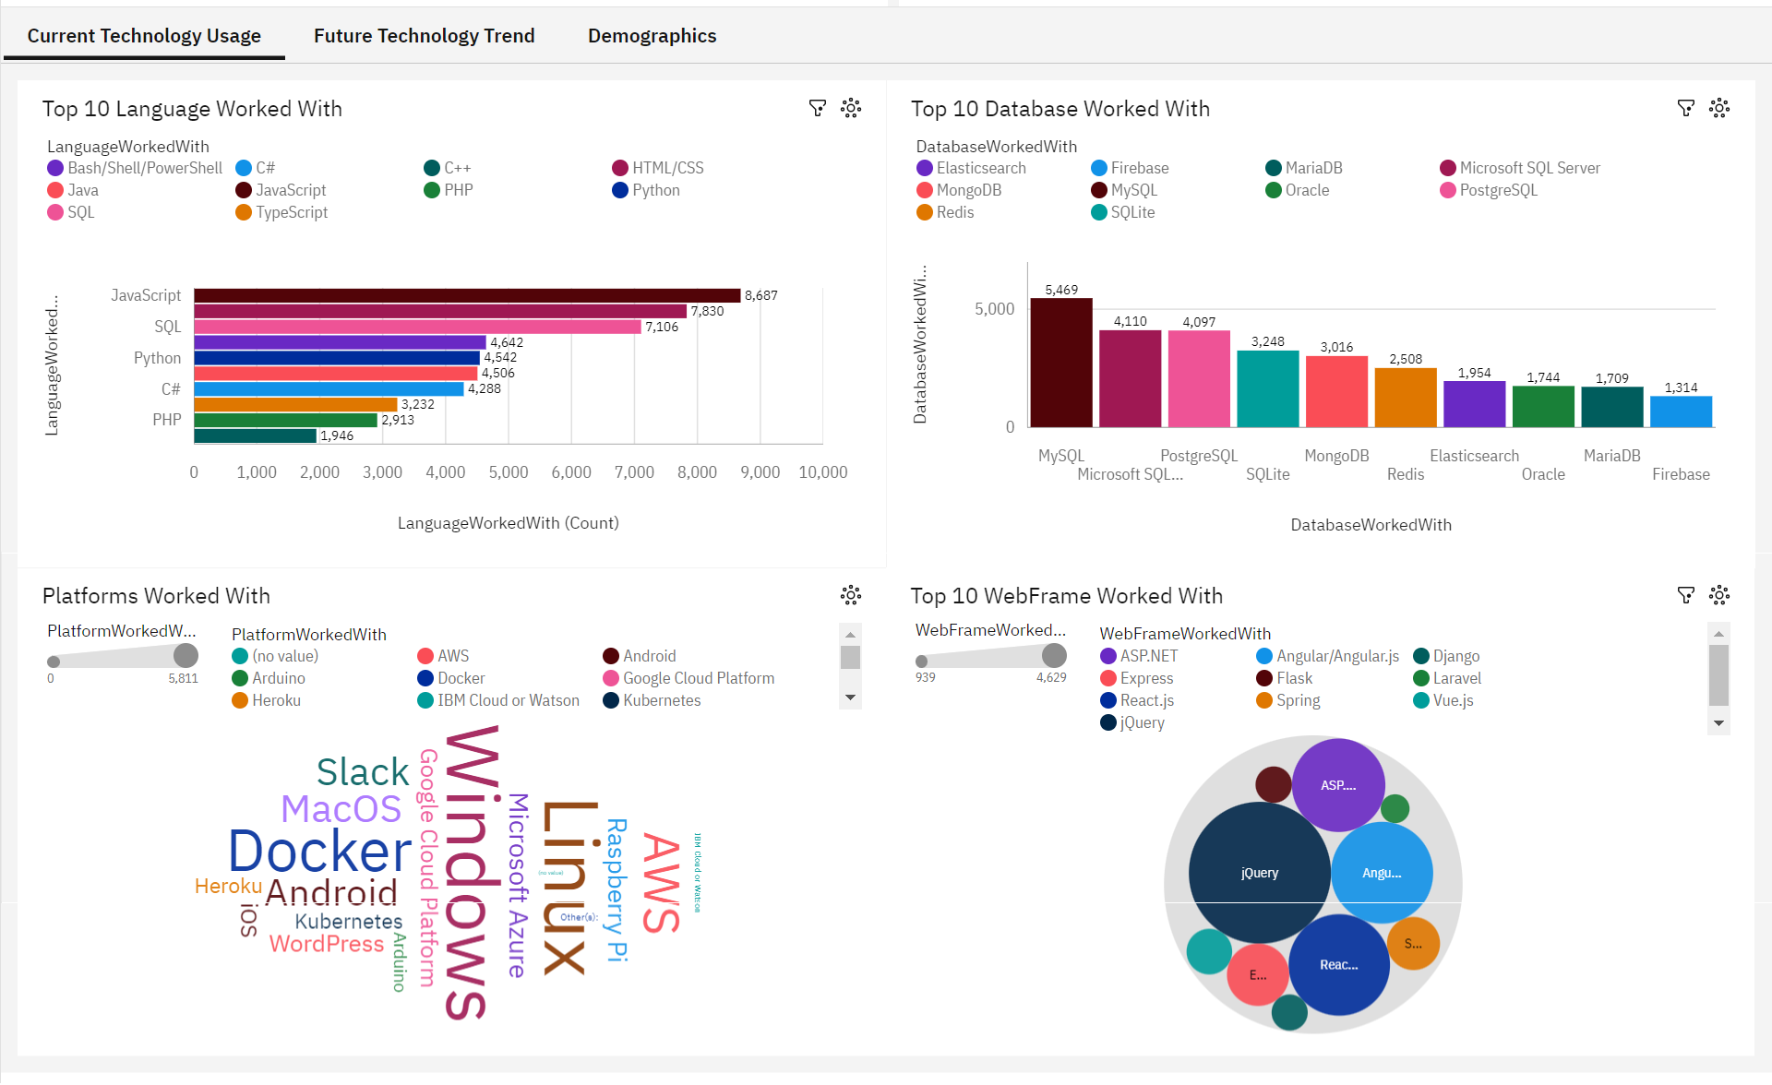
CURRENT TECHNOLOGY USAGE DASHBOARD

Slide 16
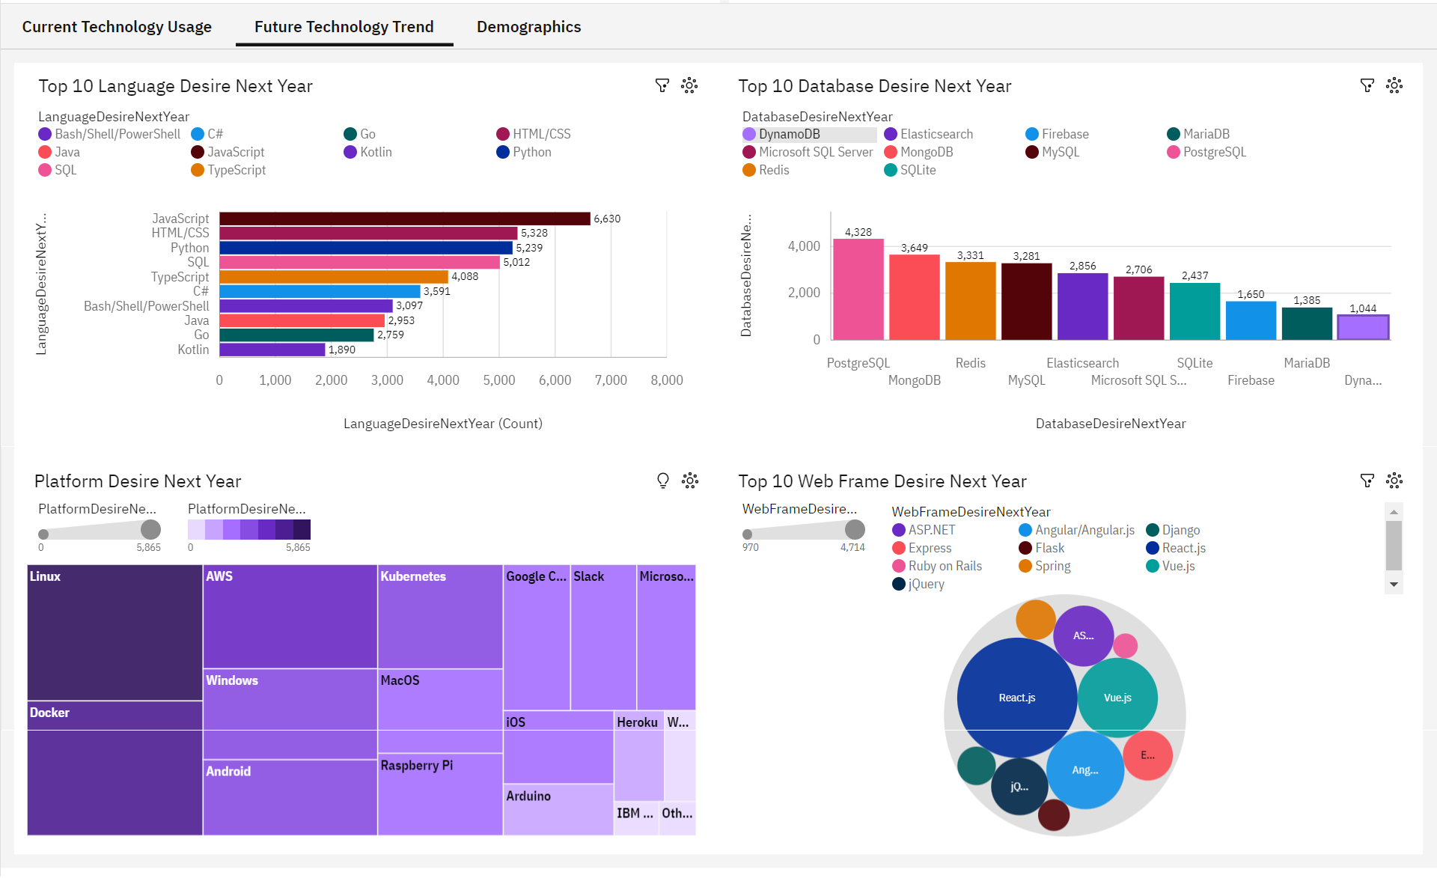
FUTURE TECHNOLOGY TREND DASHBOARD

Slide 17
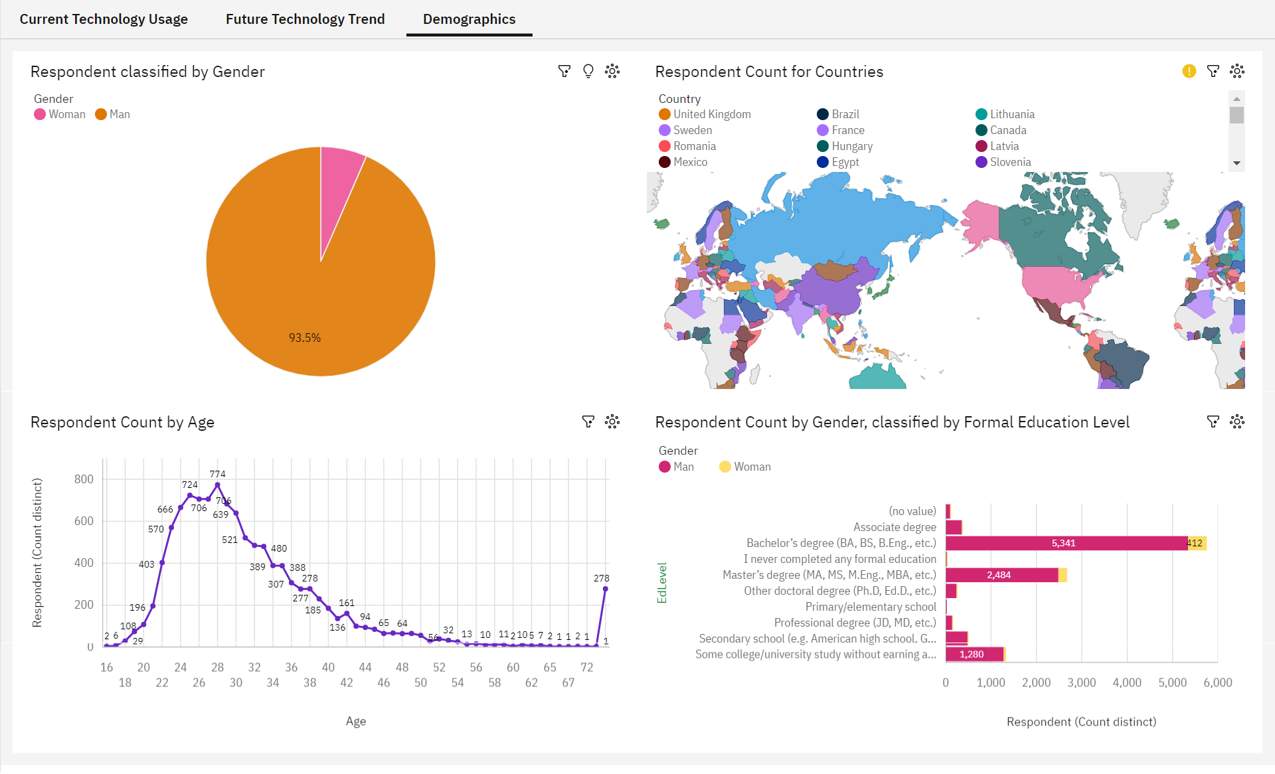
DEMOGRAPHICS DASHBOARD

Slide 18
DISCUSSION
Continuous monitoring of programming language and database trends is essential for organizations to make informed technology choices
Rapid changes in technology necessitate ongoing training and reskilling of the workforce
Encouraging more women to pursue careers in tech
Bridging the technology gap in developing countries is crucial for global economic growth and competitiveness
Equal opportunities for all candidates, regardless of age or educational background, are essential

Slide 19
OVERALL FINDINGS & IMPLICATIONS
FINDINGS
Emerging Technology Dominance:
Key technologies, such as JavaScript and Python, dominate both current and future rankings, indicating their sustained importance in the industry.
Database Preferences Shift:
While MySQL remains a popular database, there is a noticeable shift in favor of PostgreSQL, suggesting its growing appeal among developers.
Stability of Redis and Elasticsearch:
Redis and Elasticsearch consistently maintain their positions, reflecting their continued relevance for high-speed data access and search functionality.
IMPLICATIONS
Skill Development Priorities:
Organizations should prioritize skill development in JavaScript and Python for web development and data science roles to remain competitive.
Database Selection:
Consider PostgreSQL as a robust and versatile alternative to MySQL for data storage needs, taking into account specific project requirements.
High-Speed Data Access:
Redis and Elasticsearch should be considered for projects requiring rapid data retrieval and search capabilities.

Slide 20

CONCLUSION
The analysis has provided a comprehensive view of the current technology landscape, highlighting the popularity of key programming languages, databases, and web frameworks
It is evident that technology preferences can change over time
To stay competitive, individuals and organizations should prioritize skill development in technologies such as JavaScript, Python, and PostgreSQL
Ethical considerations should guide tech development to ensure responsible and inclusive use of technology

Slide 21

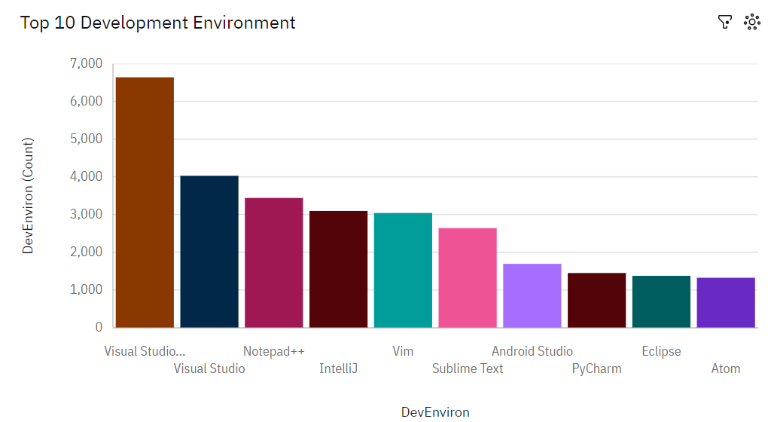
APPENDIX

Slide 22
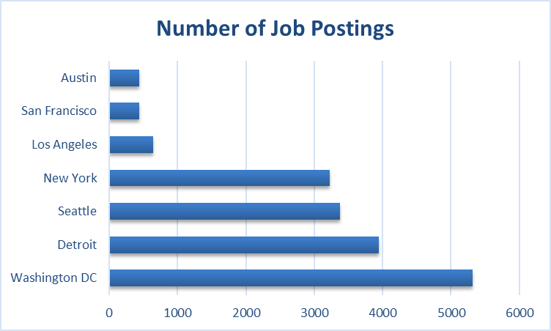
GITHUB JOB POSTINGS

Slide 23
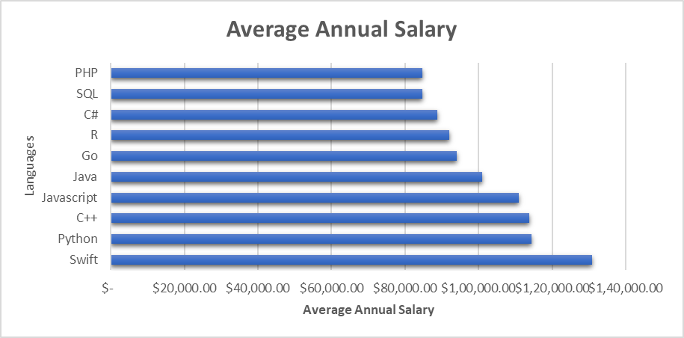
POPULAR LANGUAGES BY SALARY

